Slide 1
Dynamic CD8+ T cell responses to cancer immunotherapy in human regional lymph nodes are disrupted in metastatic lymph nodes

Slide 2
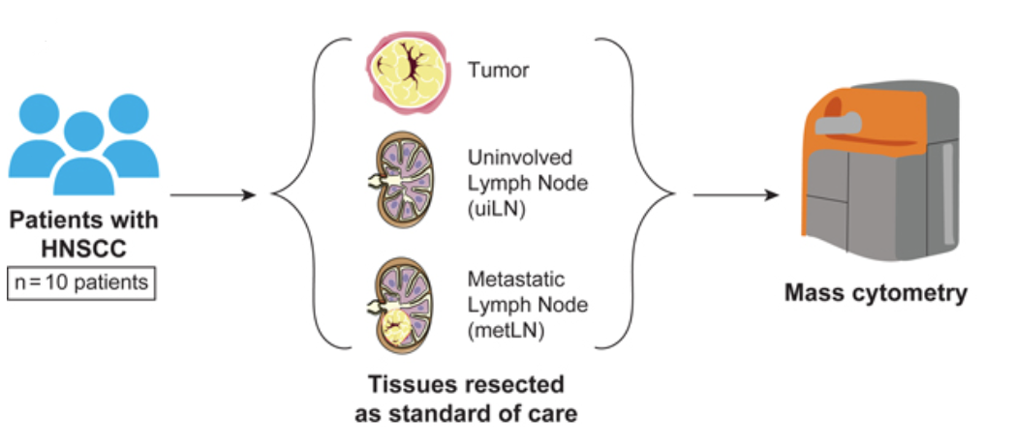
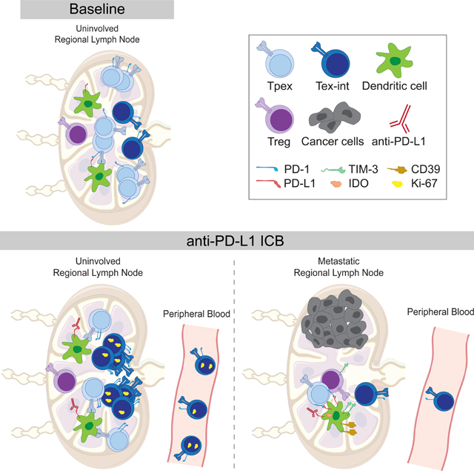
Study Design
Cancer type: Human head and neck squamous cell carcinoma (HNSCC).
5 patients with HNSCC were subjected to scRNAseq of CD8+ T cells from the tumor vs from the Lymph Node.

Slide 3
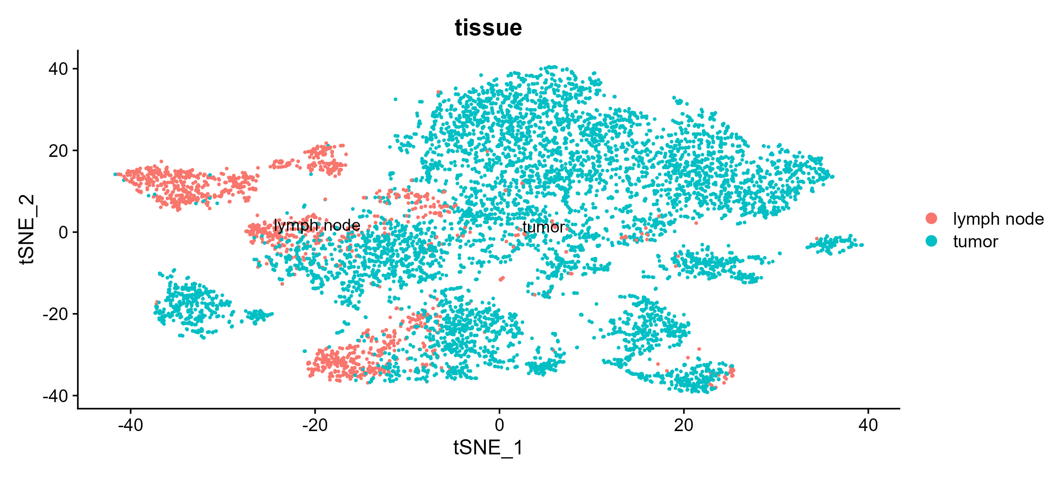
Clustering Tissue Type Composition

Slide 4
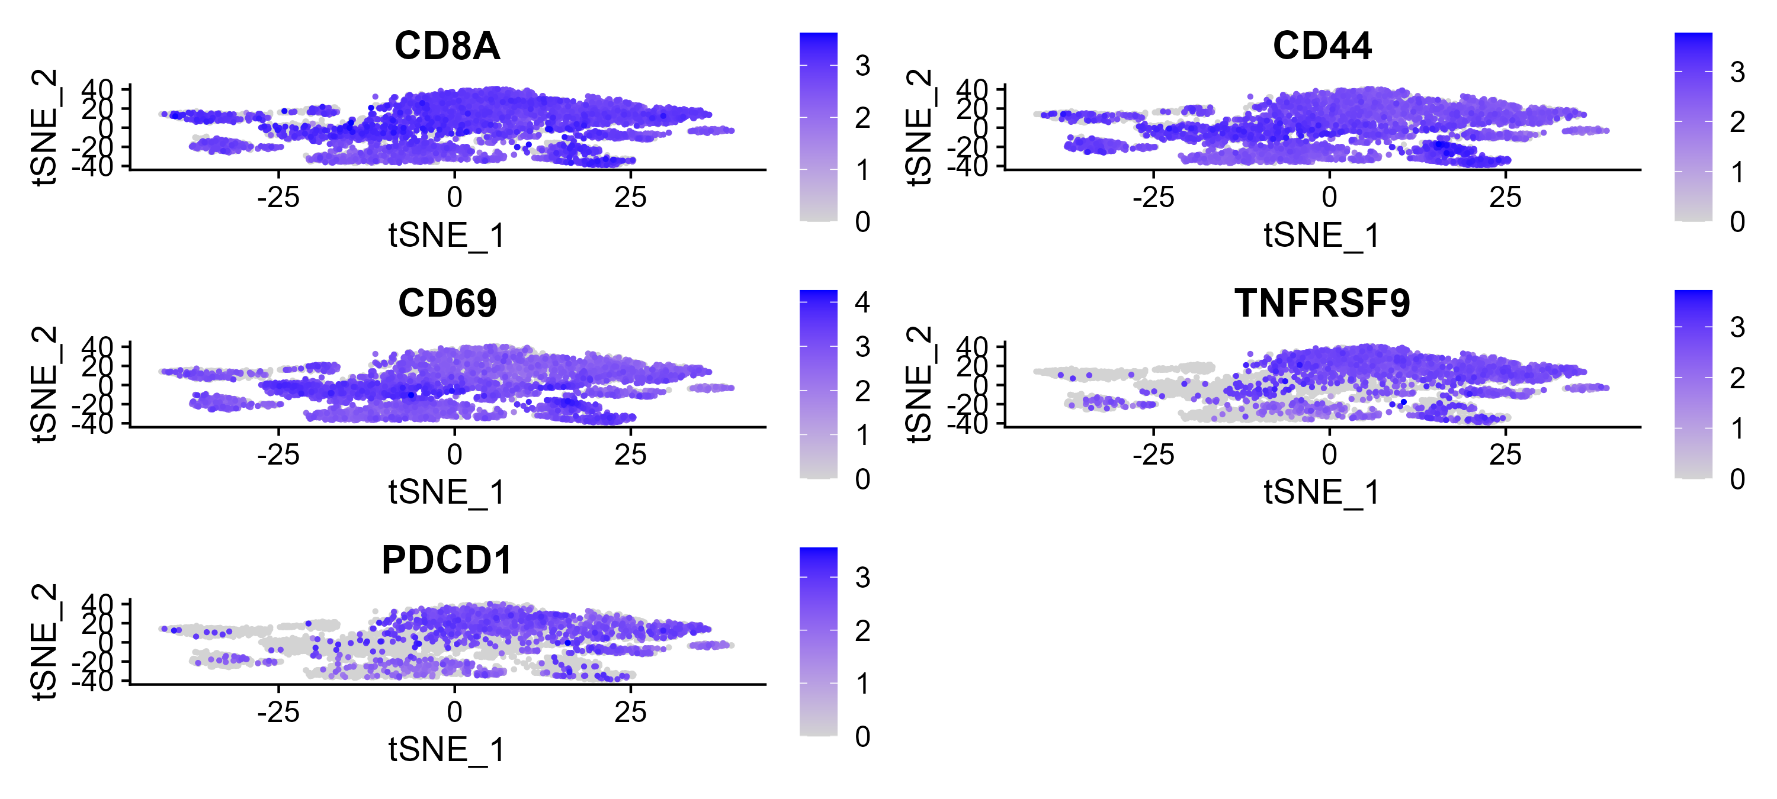
Clustering Gene expression levels
Gene expression levels of CD8A, CD44, CD69, TNFRSF9 and PDCD1 in the clustering of the data. We see that the expression of CD44 and CD69 are higher in cluster 1 than in cluster 0.

Slide 5
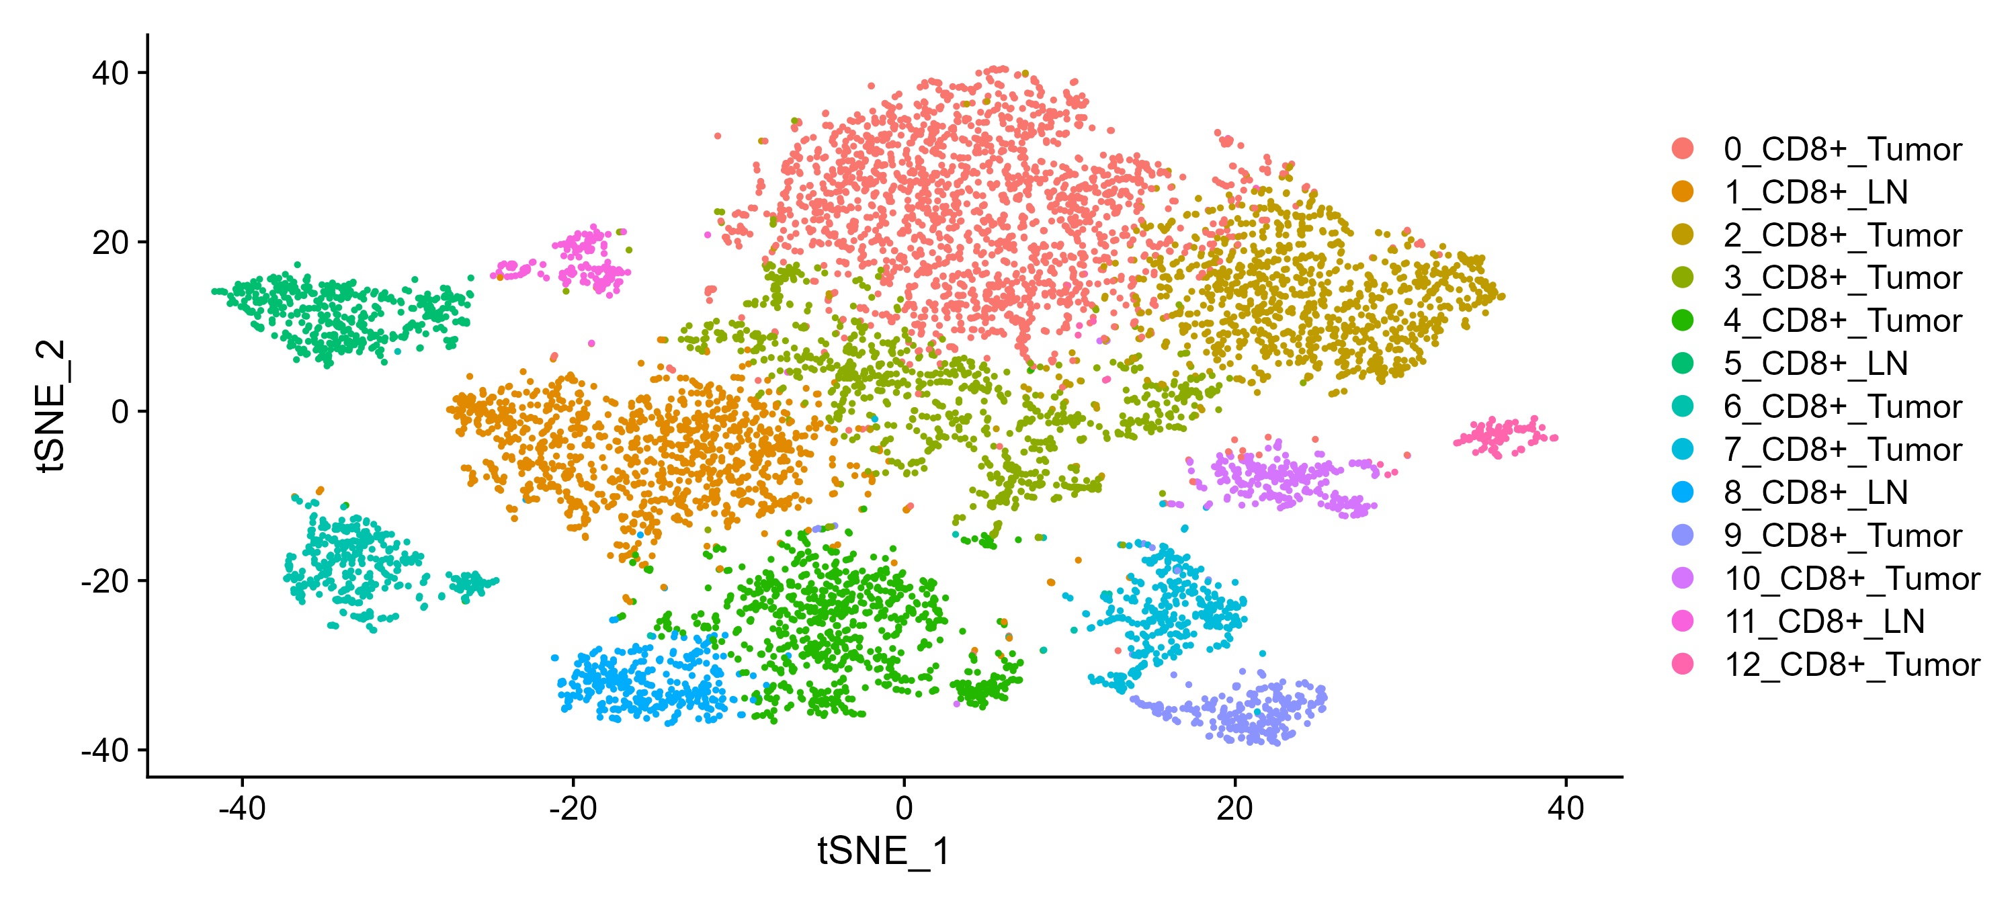
Clustering Labeled

Slide 6
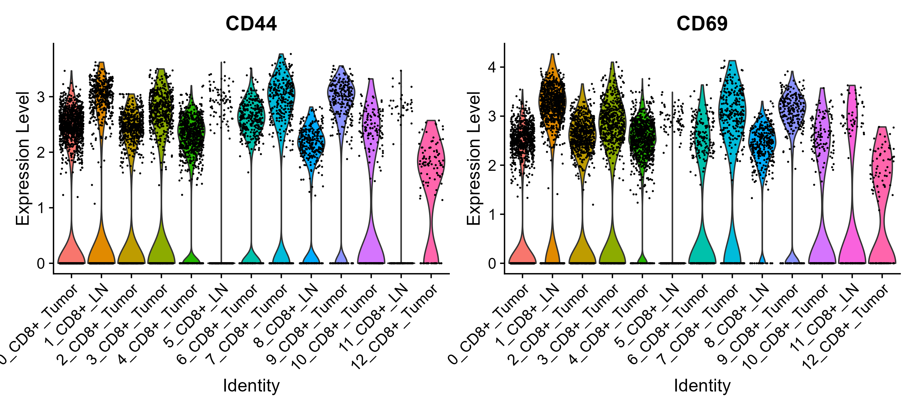
Violin Plot CD44 and CD69 Expression Per Cluster

Slide 7
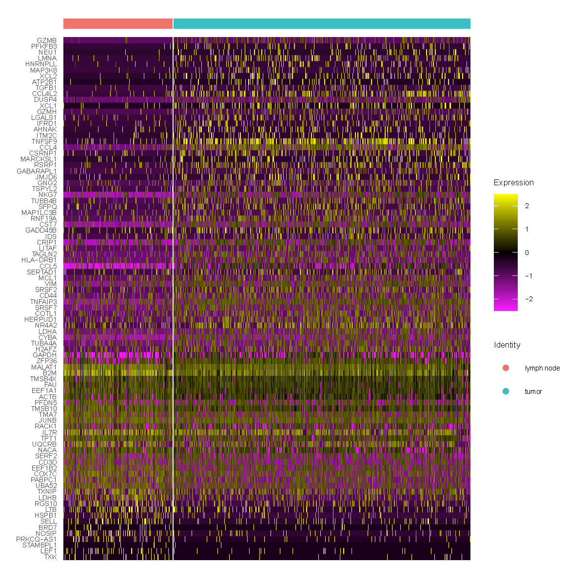
Heatmap of Cluster 1 DEGs Tumor cells vs LN cells
Differential Gene Expression was calculated between the tumor cells and LN cells in cluster 1.
Subset genes with significant FDR (<0.05) and plotted their expression levels on a heatmap.

Slide 8
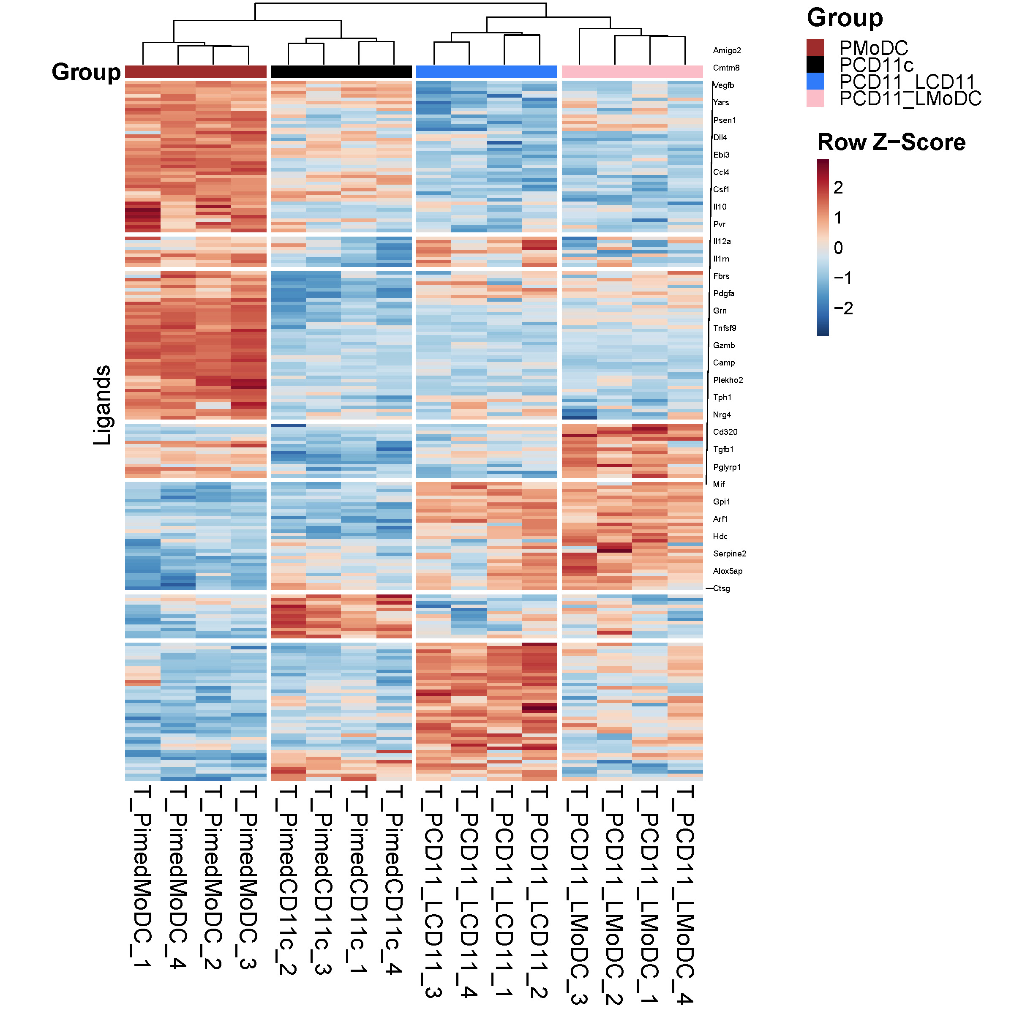
CD8+ T cells Primed/Licensed vs CD3_28 vs Naïve In Vitro Mice
Heatmap Ligands of interest:
This heatmap presents the expression of chosen Ligands’ genes from Shai Dulberg’s Ligands-Receptors gene list.
Amigo2,Cmtm8,Vegfb,Yars,Psen1,Dll4,Ebi3,Ccl4,Csf1,Il10,Pvr,Il12a, Il1rn,Fbrs,Pdgfa,Grn,Tnfsf9,Gzmb, Camp,Plekho2,Tph1,Nrg4,Cd320, Tgfb1,Pglyrp1,Mif,Gpi1,Arf1,Hdc, Serpine2,Alox5ap and Ctsg.

